Slide 1

Informative Session on FAIR principles for Biomedical Research
Carlos L. Parra-Calderón, Francisco J. Núñez-Benjumea
Institute of Biomedicine of Seville, Spain
03 Sep 2019

Slide 2
Outline
1. Theory:
What FAIR stands for?
Why go FAIR?
Open data vs FAIR data
FAIR data quality (metrics)
FAIR repositories
2. Practice:
FAIR4Health: Objectives, use cases and datasets
The FAIRification workflow
Guidelines for Biomedical Research Organizations to implement a FAIR data policy

Slide 3
Outline
1. Theory:
What FAIR stands for?
Why go FAIR?
Open data vs FAIR data
FAIR data quality (metrics)
FAIR repositories
2. Practice:
FAIR4Health: Objectives, use cases and datasets
The FAIRification workflow
Guidelines for Biomedical Research Organizations to implement a FAIR data policy

Slide 4
The FAIR Guiding Principles
FINDABLE
F1. (Meta)data are assigned a globally unique and persistent identifier
F2. Data are described with rich metadata (defined by R1 below)
F3. Metadata clearly and explicitly include the identifier of the data they describe
F4. (Meta)data are registered or indexed in a searchable resource
ACCESSIBLE
A1. (Meta)data are retrievable by their identifier using a standardised communications protocol
A1.1 The protocol is open, free, and universally implementable
A1.2 The protocol allows for an authentication and authorisation procedure, where necessary
A2. Metadata are accessible, even when the data are no longer available
INTEROPERABLE
I1. (Meta)data use a formal, accessible, shared, and broadly applicable language for knowledge representation.
I2. (Meta)data use vocabularies that follow FAIR principles
I3. (Meta)data include qualified references to other (meta)data
REUSABLE
R1. Meta(data) are richly described with a plurality of accurate and relevant attributes
R1.1. (Meta)data are released with a clear and accessible data usage license
R1.2. (Meta)data are associated with detailed provenance
R1.3. (Meta)data meet domain-relevant community standards
Wilkinson, M. D., et al. (2016). The FAIR Guiding Principles for scientific data management and stewardship. Scientific data, 3

Slide 5
Outline
1. Theory:
What FAIR stands for?
Why go FAIR?
Open data vs FAIR data
FAIR data quality (metrics)
FAIR repositories
2. Practice:
FAIR4Health: Objectives, use cases and datasets
The FAIRification workflow
Guidelines for Biomedical Research Organizations to implement a FAIR data policy

Slide 6
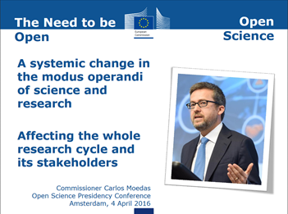
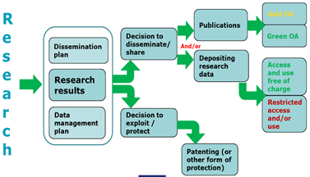
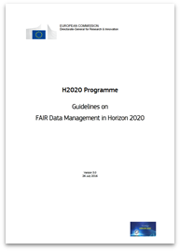
FAIR in H2020

Slide 7
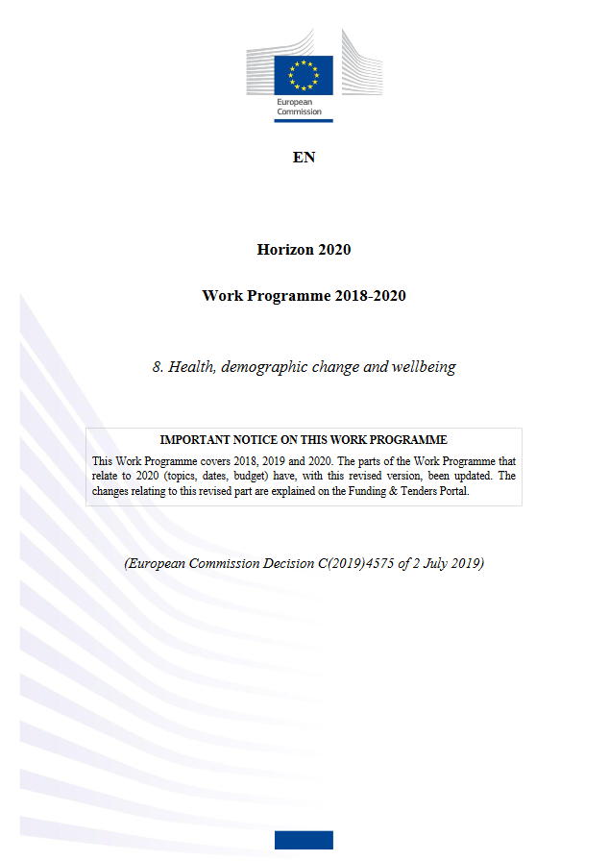
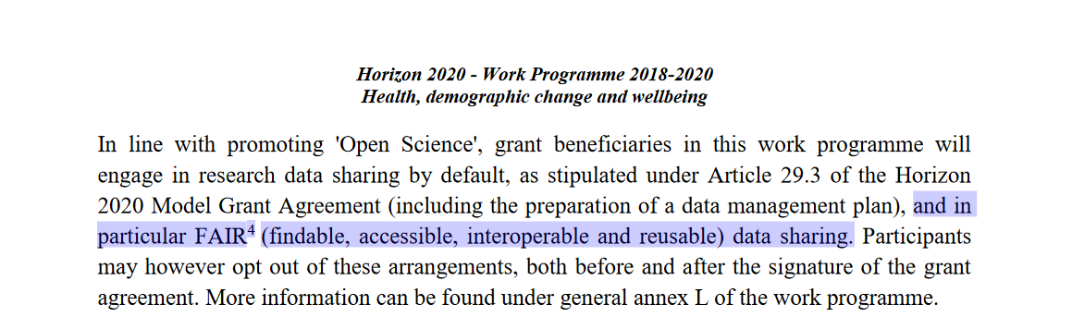
FAIR in the current H2020 WP
Explicitly mentioned in:
SC1-BHC-02-2019: Discovery of combinatorial therapies
SC1-HCO-02-2018: Data integration for personalised medicine
SC1-BHC-13-2019: Mining big data for infectious disease
SC1-HCO-20-2020: European Reference Networks
SC1-HCC-10-2020: Health research and innovation Cloud
Mobilisation of research funds in case of Public Health Emergencies
… and more is to come in the upcoming Horizon Europe WP
Horizon 2020 Work Programme 2018-2020
https://ec.europa.eu/research/participants/data/ref/h2020/wp/2018-2020/main/h2020-wp1820-health_en.pdf

Slide 8
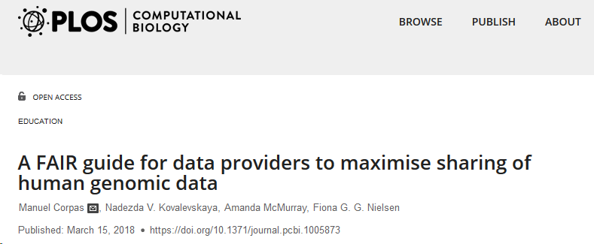

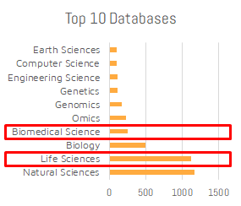
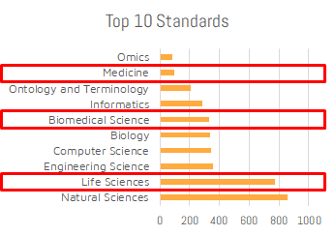



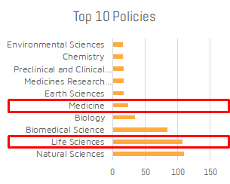
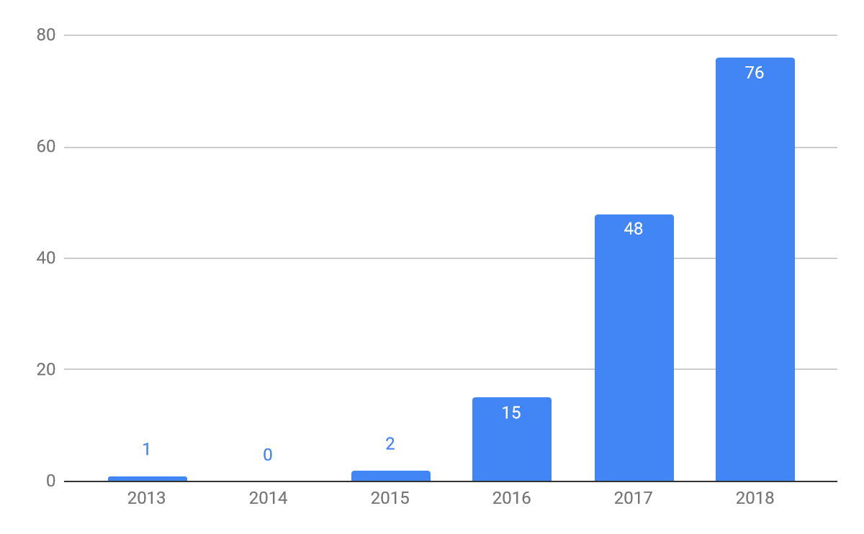
Use of FAIR data in Health
FAIR data in health (PubMed, 2018)
From: https://fairsharing.org
(Aug 2019)

Slide 9
Outline
1. Theory:
What FAIR stands for?
Why go FAIR?
Open data vs FAIR data
FAIR data quality (FAIR metrics)
FAIR repositories
2. Practice:
The FAIR4Health Project
The FAIRification workflow
Guidelines for Biomedical Research Organizations to implement a FAIR data policy

Slide 10
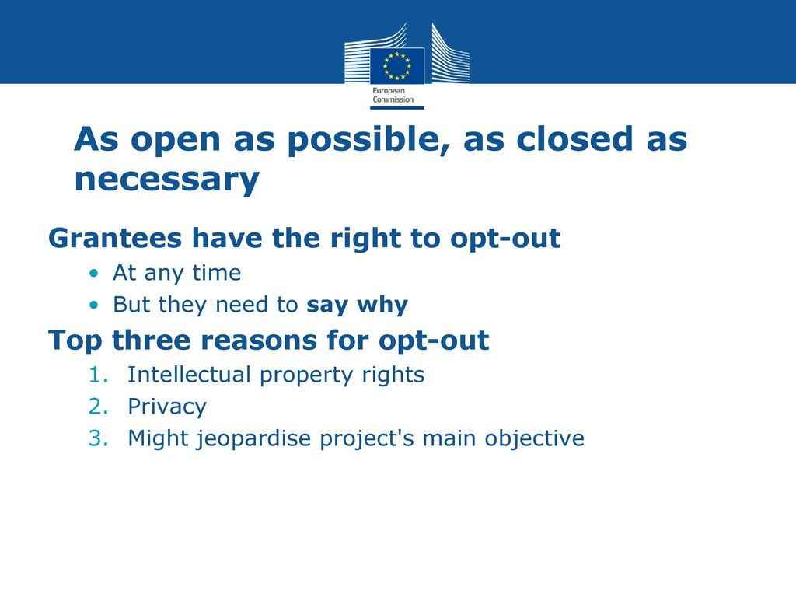
Open Data vs FAIR Data
FAIR Data is NOT Open Data
Managed Data
FAIR
data
Open Data
Source: S. Venkataraman (Digital Curation Centre, Univ. of Edinburgh)
Guidelines of FAIR Data Management in H2020

Slide 11
Outline
1. Theory:
What FAIR stands for?
Why go FAIR?
Open data vs FAIR data
FAIR data quality (FAIR metrics)
FAIR repositories
2. Practice:
The FAIR4Health Project
The FAIRification workflow
Guidelines for Biomedical Research Organizations to implement a FAIR data policy

Slide 12
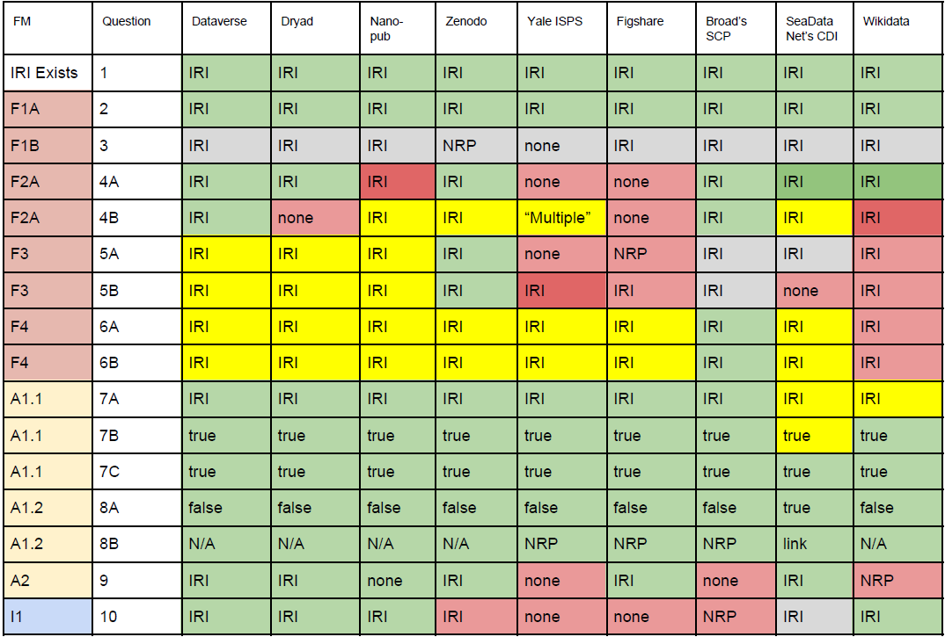
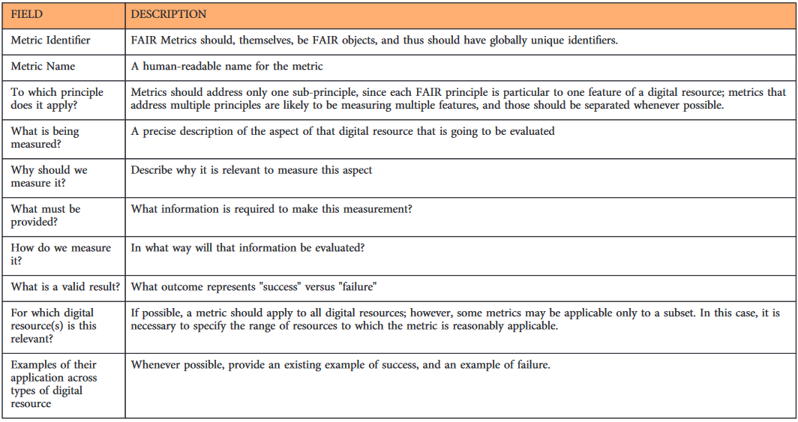
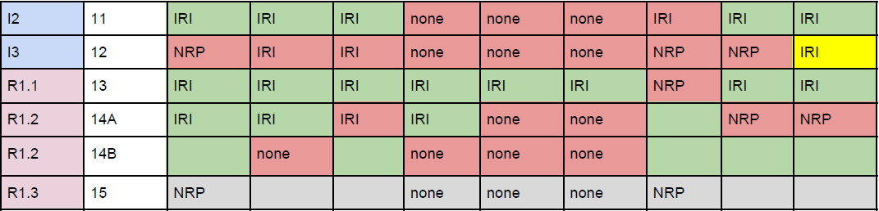
FAIR metrics
Assess the degree of FAIRness of a resource:
https://github.com/FAIRMetrics/Metrics/blob/master/MaturityIndicators/Gen1/ALL.pdf
Wilkinson, M. D., et al. (2018). A design framework and exemplar metrics for FAIRness. Scientific data, 5

Slide 13
Outline
1. Theory:
What FAIR stands for?
Why go FAIR?
Open data vs FAIR data
FAIR data quality (FAIR metrics)
FAIR repositories
2. Practice:
The FAIR4Health Project
The FAIRification workflow
Guidelines for Biomedical Research Organizations to implement a FAIR data policy

Slide 14



FAIR repositories
FAIR data HLEG: https://ec.europa.eu/info/sites/info/files/turning_fair_into_reality_1.pdf
Rec. 20: Deposit in Trusted Digital Repositories
Research data should be made available by means of Trusted Digital Repositories, and where possible in those with a mission and expertise to support a specific discipline or interdisciplinary research community.
https://fairsharing.org
Rec. 9: Develop assessment frameworks to certify FAIR services
Data services must be encouraged and supported to obtain certification, as frameworks to assess FAIR services emerge. Existing community-endorsed methods to assess data services, in particular CoreTrustSeal (CTS) for trusted digital repositories, should be used as a starting point to develop assessment frameworks for FAIR services. Repositories that steward data for a substantial period of time should be encouraged and supported to achieve CTS certification.
https://re3data.org
https://www.nature.com/sdata/policies/repositories

Slide 15
Outline
1. Theory:
What FAIR stands for?
Why go FAIR?
Open data vs FAIR data
FAIR data quality (FAIR metrics)
FAIR repositories
2. Practice:
The FAIR4Health Project
The FAIRification workflow
Guidelines for Biomedical Research Organizations to implement a FAIR data policy

Slide 16

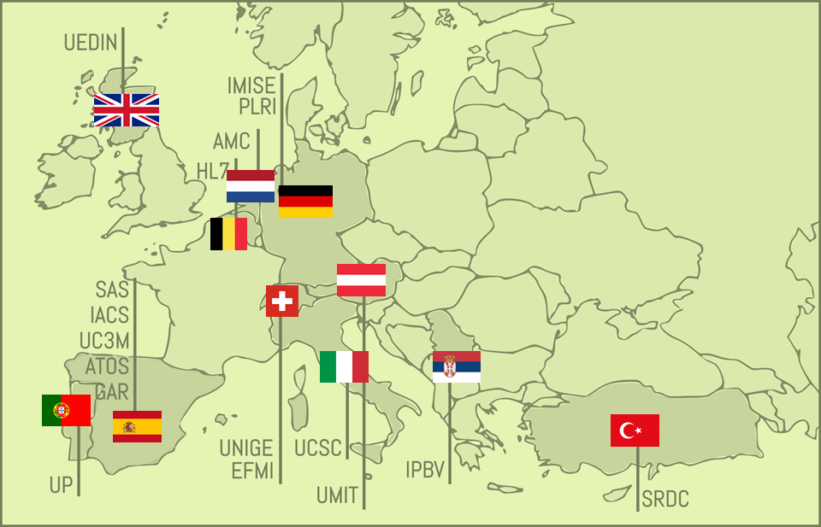
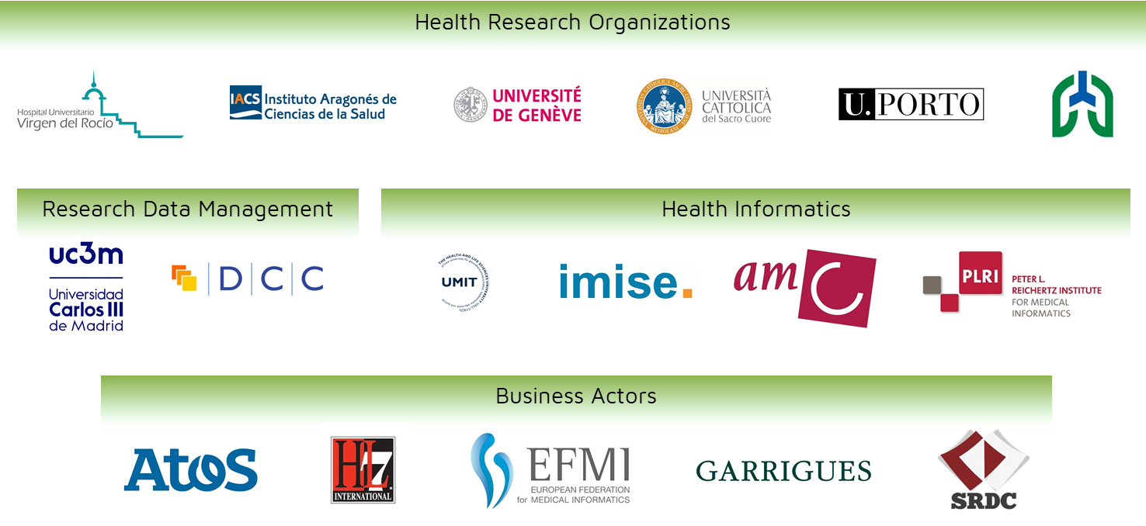

Improving Health Research in EU through FAIR data
OBJECTIVES
To facilitate and encourage the EU Health Research community to FAIRify, share and reuse their datasets derived from publicly funded research initiatives through the demonstration of the potential impact that such strategy will have on health outcomes and health research.
1. OUTREACH STRATEGY AT EU LEVEL
2. FAIR DATA CERTIFICATION ROADMAP
3. TECHNOLOGICAL PLATFORM
4. DEMONSTRATE POTENTIAL IMPACT
EC funding: 2,999,053.75 €
www.fair4health.eu
@FAIR4Health
Notes:
First of all, I’d like to thank the organisers for the opportunity to share with you our project. FAIR4Health started on last December and we are looking forward to establish collaborations and synergies at any level with all EU initiatives dealing with FAIR data in the health domain. So in case you are involved in other similar initiatives, please don’t hesitate to contact me at the end of the session and I will put you in contact with the coordinators to set out potential collaborations.

Slide 17


Demonstrators
Innovative eHealth services based on FAIR data reuse
#1 To support the discovery of disease onset triggers and disease association patterns in comorbid patients and demonstrate the reproducibility of research.
#2 To develop and pilot a prediction service for 30-days readmission risk in complex chronic patients
Notes:
FAIR4Health will design, develop and demonstrate 2 pathfinder use cases, in this case they will be innovative eHealth services based on FAIR data reuse.
The first one will address the feasibility for health researchers to work with FAIRified and federated datasets to support the discovery of disease onset triggers and disease association patterns in comorbid patients, and demonstrate the reproducibility of such research.
The second one will address the development of an innovative prediction service for 30-days readmission risk in complex chronic patients making use of a privacy preserving distributed data mining approach.

Slide 18
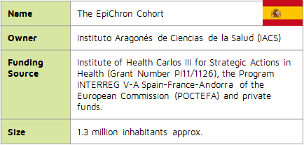
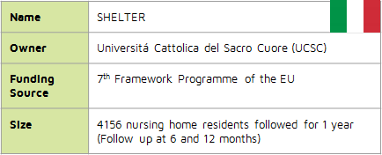
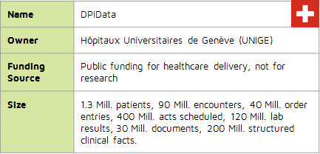
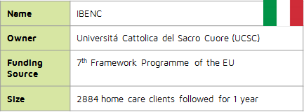
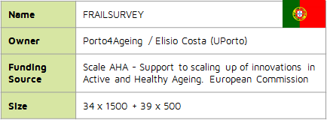
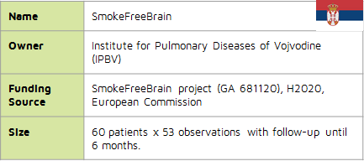

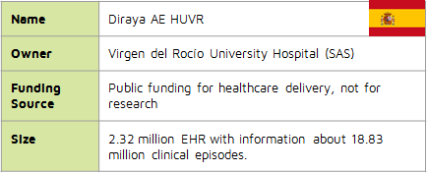
Datasets
Health and social care data from 5 million of subjects

Slide 19
FAIR4Health Vision
Open Community
eHealth Provider
eHealth Provider
eHealth Provider
eHealth Services Providers
eHealth Services Providers
Healthcare Providers
Healthcare Provider
Healthcare
Providers
Healthcare Provider
Research Institution
Research Institution
Research Institution
Health Research Institutions
Health Reseach Institutions

Slide 20
Outline
1. Theory:
What FAIR stands for?
Why go FAIR?
Open data vs FAIR data
FAIR data quality (FAIR metrics)
FAIR repositories
2. Practice:
The FAIR4Health Project
The FAIRification workflow
Guidelines for Biomedical Research Organizations to implement a FAIR data policy

Slide 21






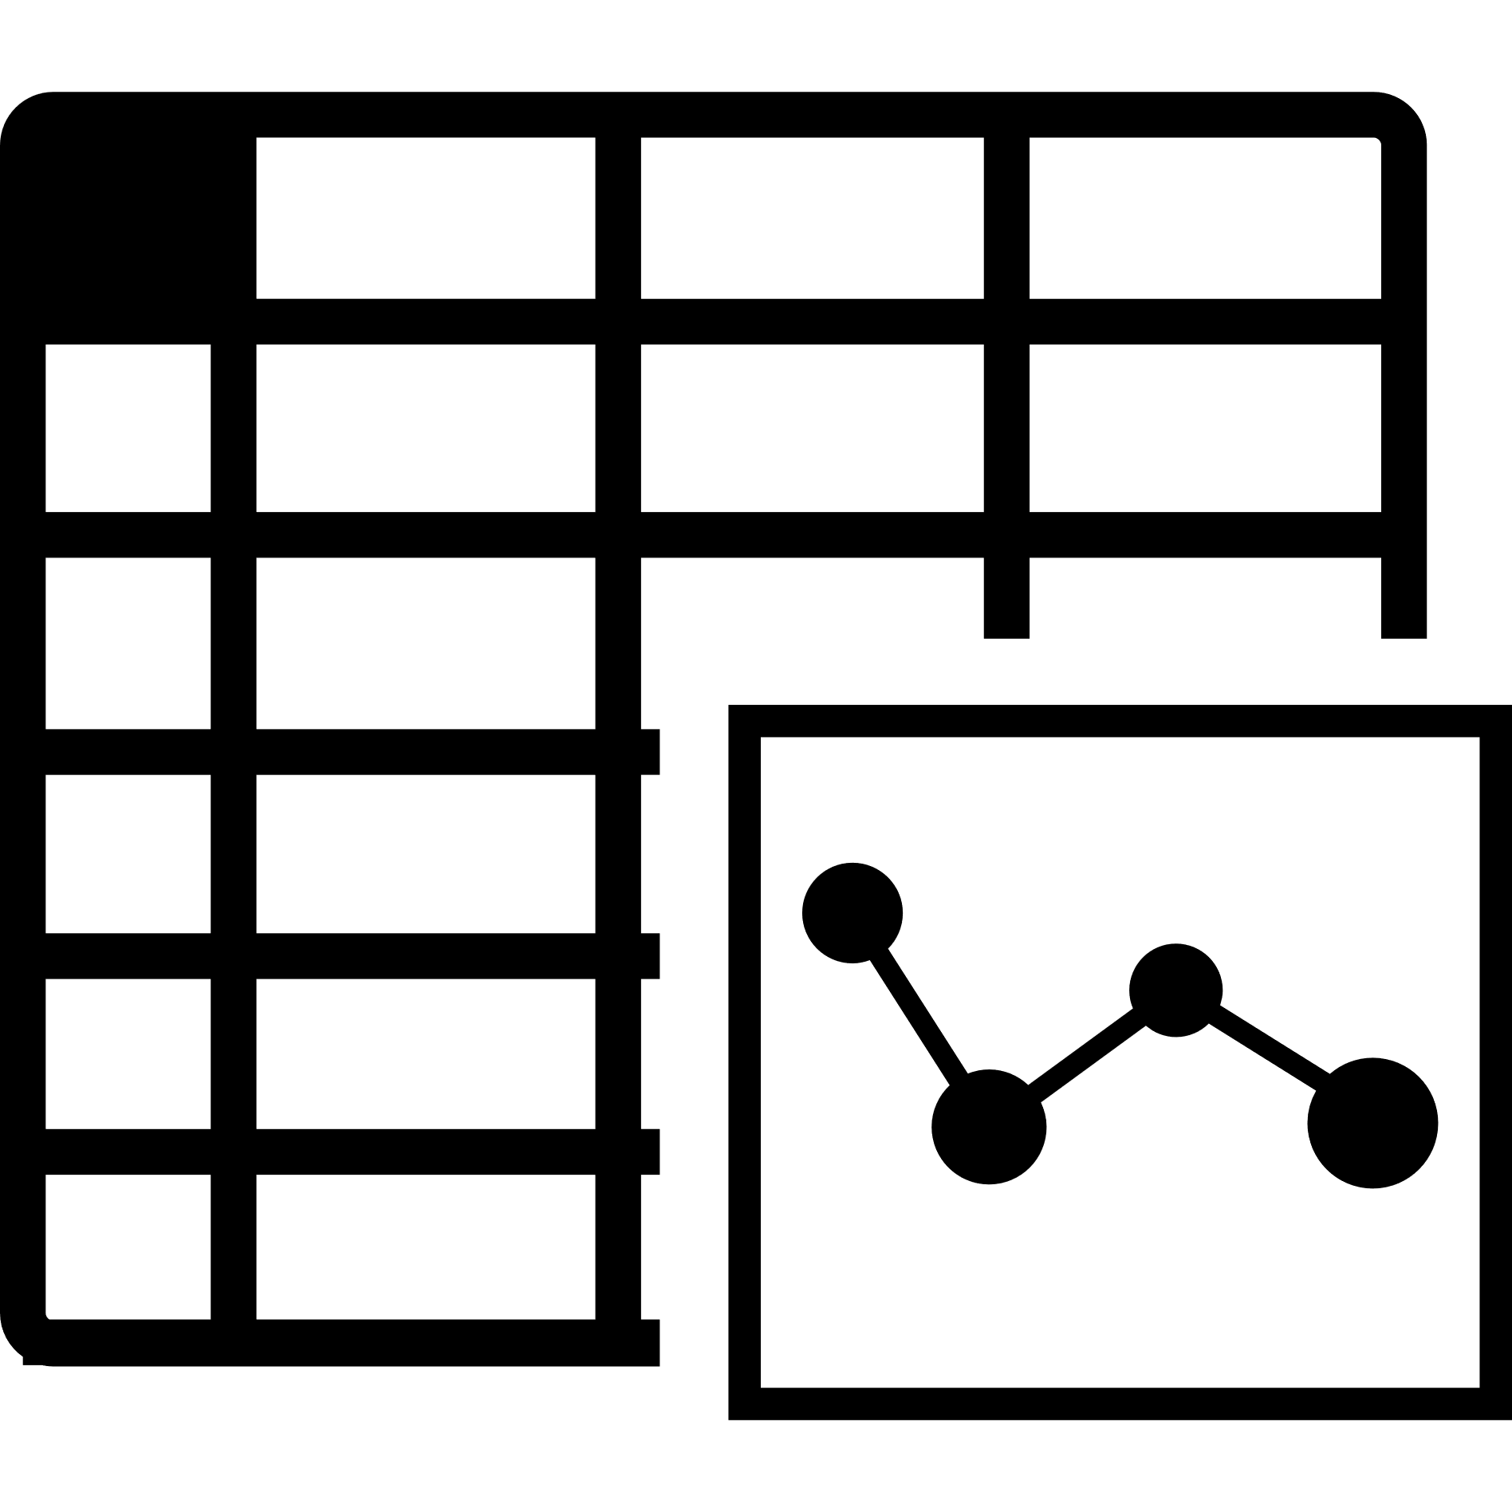

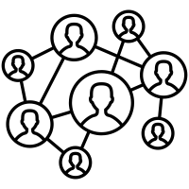
FAIRification workflow
RAW
FAIR

Slide 22

FAIRification workflow
RAW
Raw data analysis
Curation and validation
Anonymisation
License attribution
Make data linkable
Semantic modeling
Data versioning
Metadata aggregation
Archiving
FAIR

Slide 23
Outline
1. Theory:
What FAIR stands for?
Why go FAIR?
Open data vs FAIR data
FAIR data quality (FAIR metrics)
FAIR repositories
2. Practice:
The FAIR4Health Project
The FAIRification workflow
Guidelines for Biomedical Research Organizations to implement a FAIR data policy

Slide 24
Principles
01
Strategic Vision
The implementation of FAIR policy implies to manage a complex change
02
Resources
There are no policies without resources and incentives supported by the needed infrastructure
03
Skills
Need to count with right knowledge and skills about FAIR data and research data management
04
Action Plan
The FAIR policy implementation must follow a clear action plan, identifying main actors and a credible timeline
05
Approval
The FAIR policy must be written down and approved by the institution
Notes:
To implement a FAIR/Open data policy implies to manage a complex change. The policy needs strategic vision and leadership.
There are not policies without resources and incentives supported by necessary Infrastructure.
It is necessary to count with the right knowledge and skills about FAIR data and research data management in the current Open Science landscape.
Before implementing any Open/FAIR data policy, the institution needs a clear action plan identifying the main actors and a credible timeline.
The policy must be written down and approved by the institution.

Slide 25
Guidelines: 10 Steps
1. Vision and Objectives
2. Responsible Team
3. Raise Awareness
4. Data Infrastructure
5. Good Practices
Describe current research, funders and their policies, research outcomes and infrastructure.
Define the objectives of the policy.
Adoption of overcoming mechanisms to enhance data sharing
Design an action plan
State resources and a feasible timeline
Provide training and assistance to researchers.
Definition of skills and a training programme
Identify and describe data storage and architecture.
Provision of tools to make data FAIR.
Research outcomes should be deposited in trustworthy repos.
Establish responsible RDM practices.
Define FAIR for implementation.
Creation of standard institutional template for DMP

Slide 26
Guidelines: 10 Steps
6. Openness
7. Standards
8. Incentivize
9. Implement
10. Assess
Determine the level of openness, transparency and re-usability of research outputs, including licensing, provenance and mechanisms for data protection
Technical decisions must be adopted regarding persistent IDs and metadata schemas for accessibility and interoperability.
Include a technical analysis of domain-specific standards
Devise credit and reward mechanisms to encourage researchers to apply the FAIR data policy
1. Write the policy
2. Submit for approval
3. Disseminate
Provide mechanisms for FAIR data assessment within the institution.
Re-align and consolidate with funders.
Notes:
Devise credit and reward mechanisms in order to ensure researchers consider it is worth allocating time and energy to data management/sharing.
Write the policy in Open/FAIR research data management
à Submit it to approval in your governance bodies
Þ Disseminate the policy inside the HRPO.
Create mechanisms for FAIR data assessment within the institution.
Re-align and consolidate the policy with the funders to guarantee that publicly-funded research data are made FAIR and Open, except for legitimate restrictions.

Slide 27
Key messages to take-away
No FAIR ⇒ no EU funding
FAIR is NOT Open
Institutional support

Slide 28



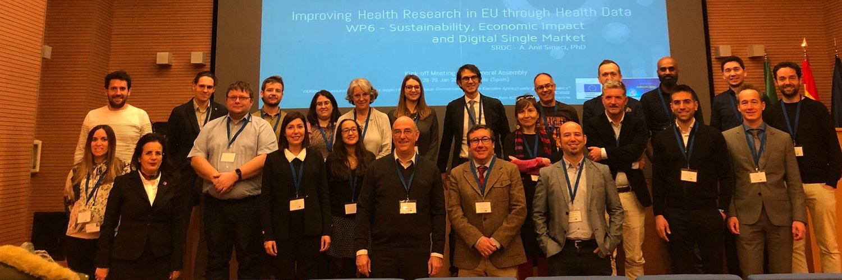
THANK YOU!
info@fair4health.eu
fair4health.eu
@fair4health

